Slide 1
SOLARITY
SOLARITY
2021
The truly scalable cross
chain metaverse for DAOs
© 2021. All Rights Reserved

Slide 2
Vision
Solarity aims to be significantly improve standards for these fields:
People
Metaverse
Users rule through a scalable and interconnected DAO infrastructure, power to creators through NFTs
Socialize more through a more interesting way to interact
Make XR technologies accessible to everybody through cloud
Open metaverse where everybody can own and power NFTs through virtual land
VR compatible applications, providing tools to create your own VR experience cross chain structure
The green metaverse: energy saving chains
DAOS
Bring DAOs members engagement to the next level in a virtual world
Make different DAOs interact more thanks to a cross-DAO interaction
Provide a structure with just a click

Slide 3
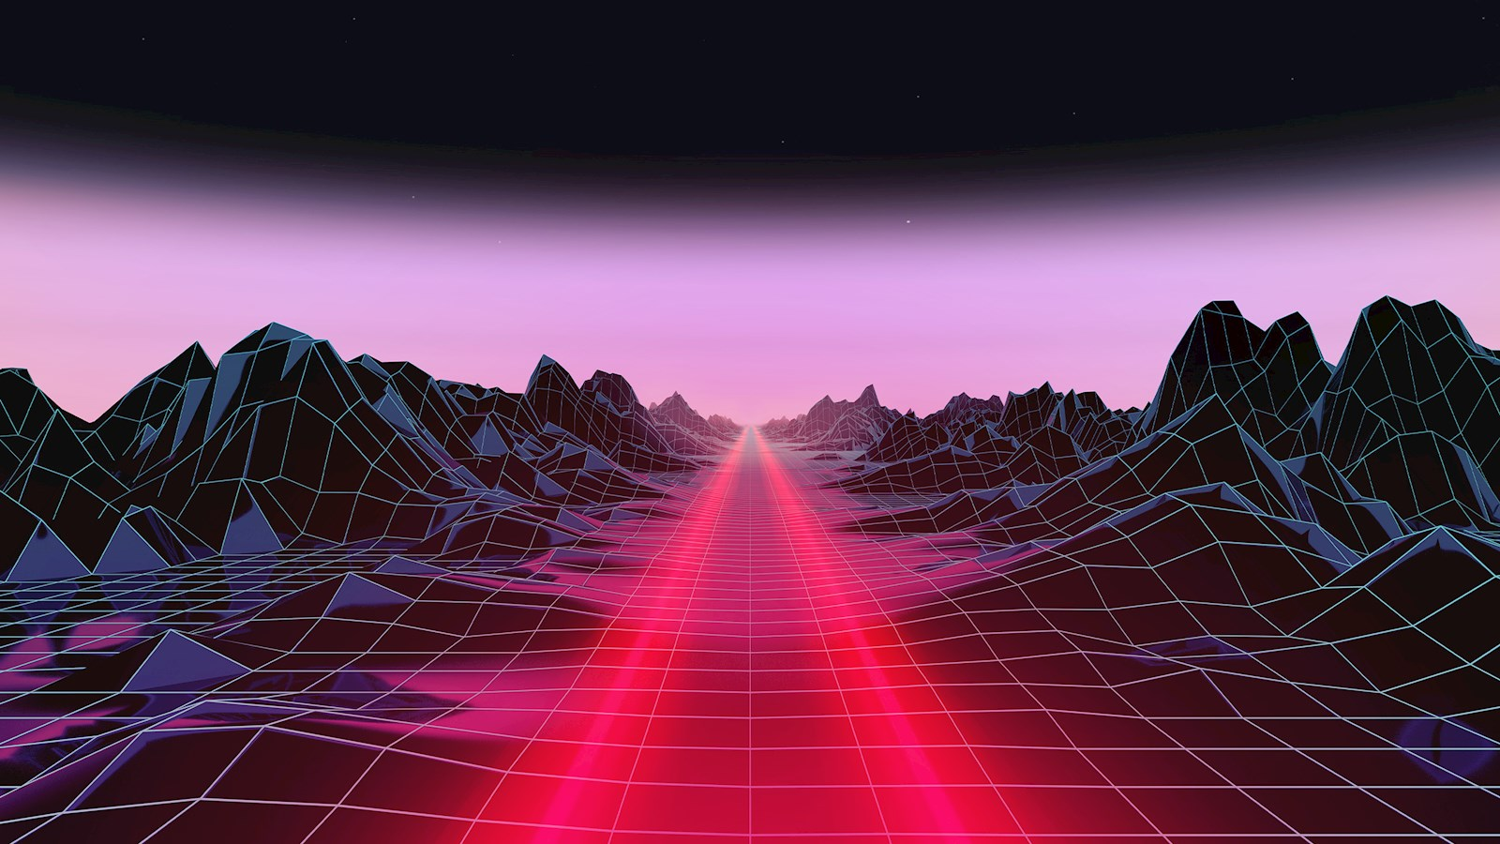


SOLARITY
Solarity as the metaverse provider
Interconnected DAOverses Galaxies
VR studios
Gamefi/Defi/
Metaverse projects
Brands
Solarity
Cross-metaverse XR aggregator
MetaDots
Self-Sovereign Cosmos zones connected by IBC
Poly-Verse
Ⓒ SOLARITY 2021. All rights reserved
3

Slide 4
For the Open Metaverse Community
Daos as a service, providing 2 Symmetrical DAO structures
Hyper-scalable and replicable
Each Metaverse with its own Metaverse Currency / Community Token & its own Economic & Fiscal policies
Features
NeghiVERSE
Land as services
Expansion allow to host more DAO customers
The two atomical DAOverses based on Game Theory
PosiVERSE
Land as reward
Expansion allow to host more DAO members
For Solarity’s Land Owners
Self-sustainable through an innovative Crypto-economic system
DeFi treasuries to scale VR Worlds
Solana for cheap and fast transactions and for a truly scalable metaverse

Slide 5
SolVegas for profit DAO
Features
World Engineers
a non profit DAO
VR Devs
a non profit DAO
Casino Employees
a non profit Dao
member
For profit Treasury
member
member
World Designers
a non profit DAO
Non profit Treasury
Casino Employees
a non profit Dao
member
member
member
member
member
Users and advertisers bring money to SolVegas treasury

Slide 6



Gaming
Virtual World (decentraland)
MMORPG (GTA)
P2E games / Launchpad for Indie Game Devs
Use
Cases
Creators
Community meeting point
Interactive NFT marketplace
Concerts and events
Next level interactions
Businesses
Subscription model (Tinder, Netflix)
Membership model (Any DAOs, Clubs)
Virtual World (decentraland)
MMORPG (GTA)
P2E games / Launchpad for Indie Game Devs
Community meeting point
Interactive NFT marketplace
Concerts and events
Next level interactions
Subscription model (Tinder, Netflix)
Membership model (Any DAOs, Clubs)

Slide 7
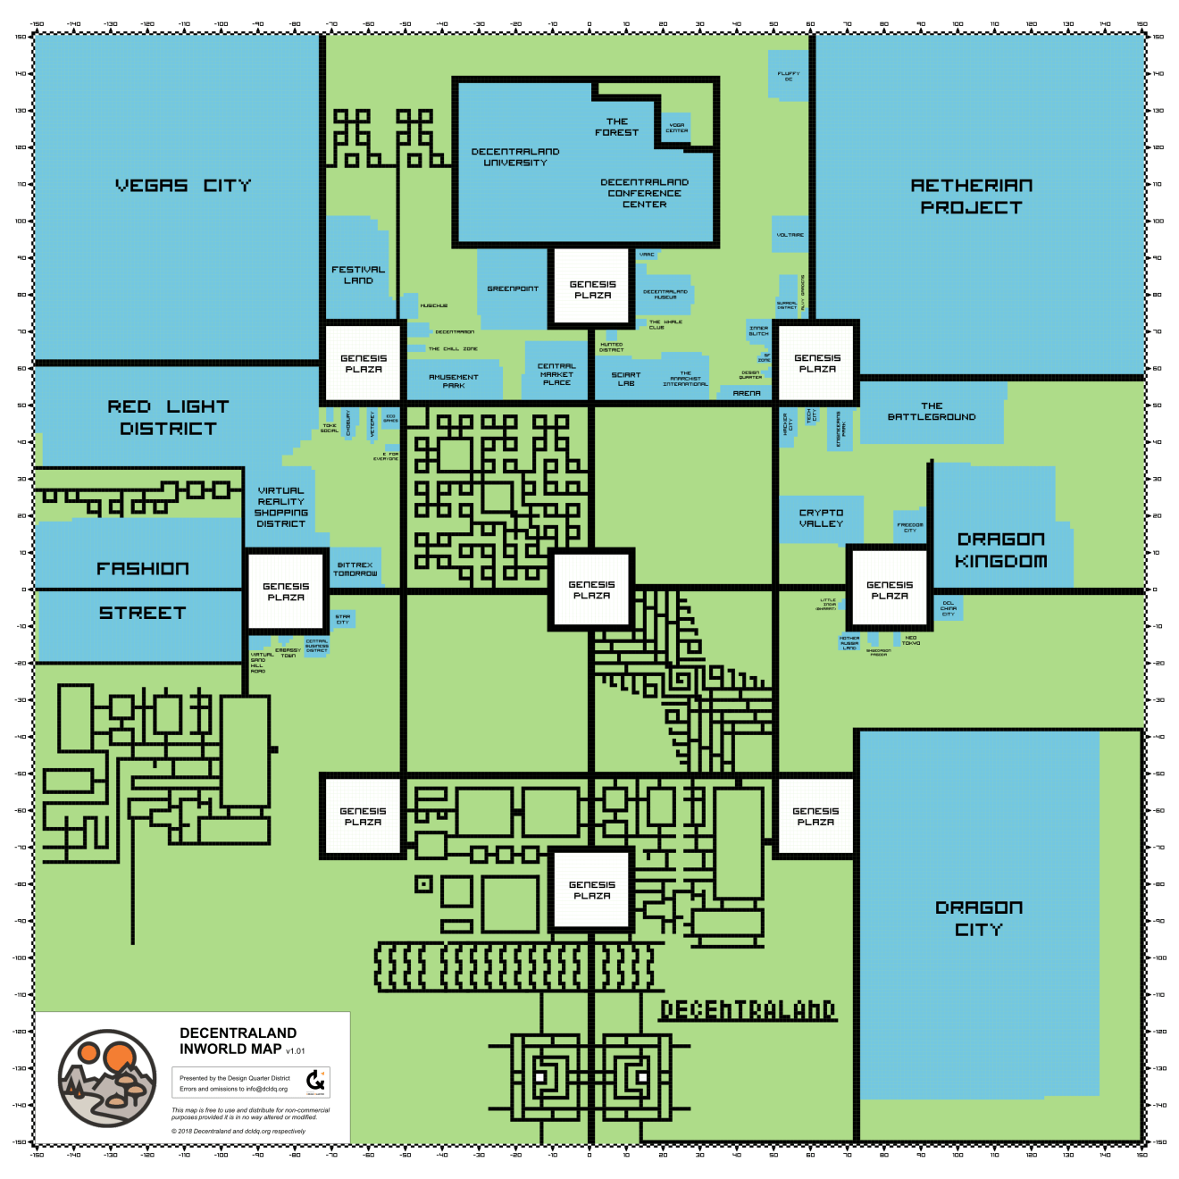
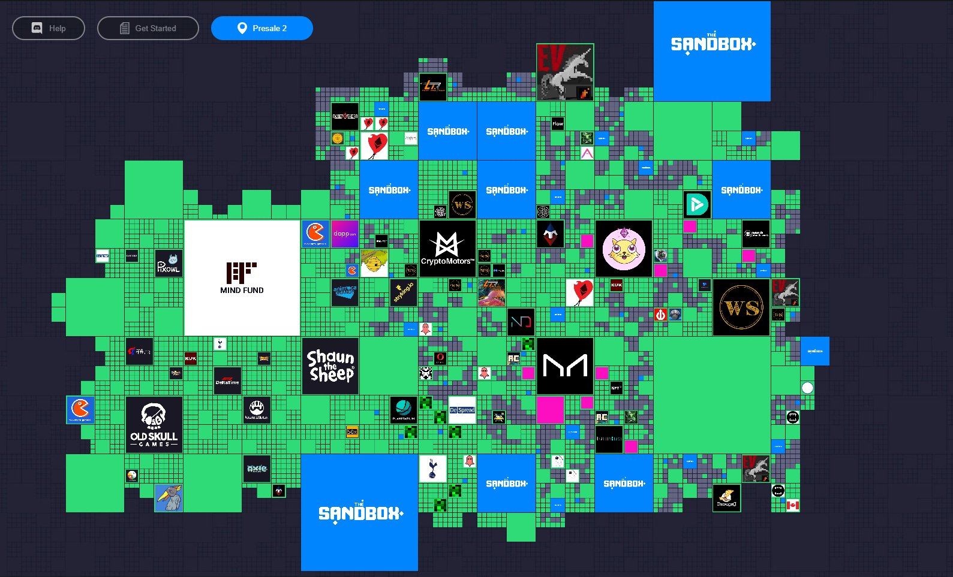
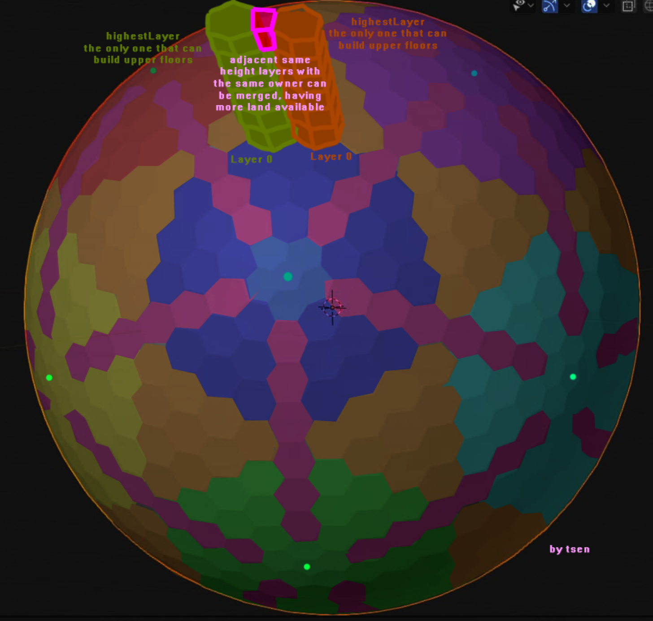
Landonomics Comparison
(Virtual Worlds Stats, Land ecc)
Decentraland flat
Sandbox flat
Solarity spherical
1 Tile
16m x 16m
96m x 96m
10m x 10m
Total Parcels
90601
166.646
1000, expandable up to 3’147’212
Total different owners
5.6k
15.6k
Land Upgrades
Not available
Not available
Available
Land Floor
3.7 ETH
0.78 ETH
0.01 SOL

Slide 8

Tokenomics
Community token
Land and NFTs
Govern treasury & crypto-economic system, non transferable. (burn community Tokens to get more)
Buy, sell, upgrade and govern your land (Land Ownership = Protocol Governance) Buy with community token
Tokenomics & economic cycles
The Self-sustainability of the platform is guaranteed by the ingenious design of its Economy combining an inflationary Metaverse Currency, a Staking period to be eligible as a recipient of inflation (100% of inflation to Early Stakers), a Dynamic Bonding Curve for Land Upgrade Costs (denominated in metaverse currency) and an initial low supply vs supply needed for world development (6370 Economic Cycles each of 314M Tokens, the initial supply)

Slide 9



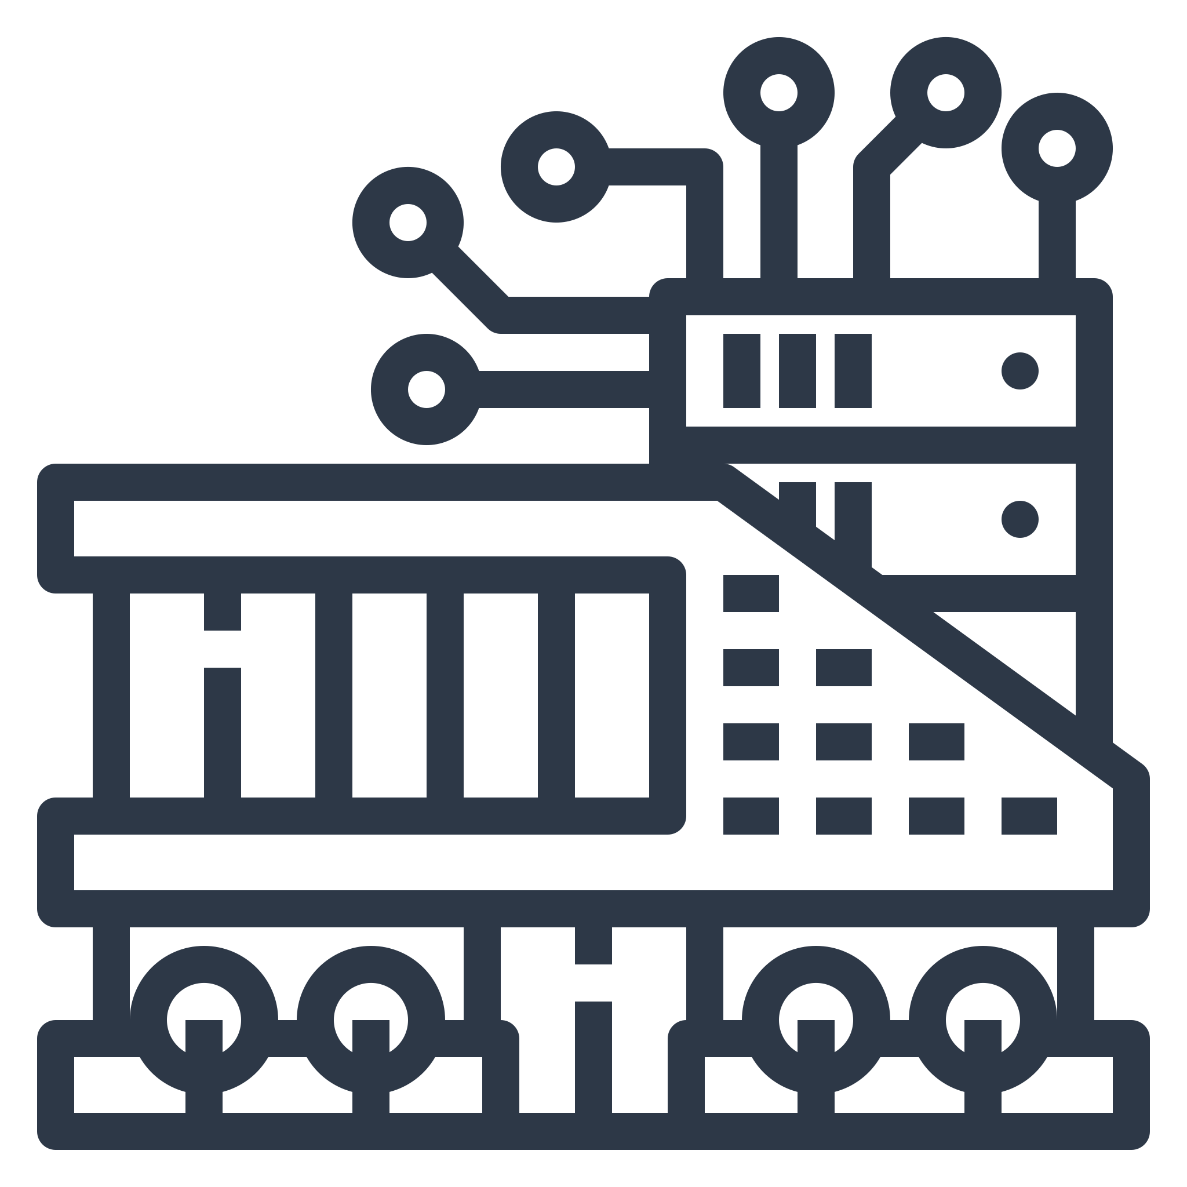
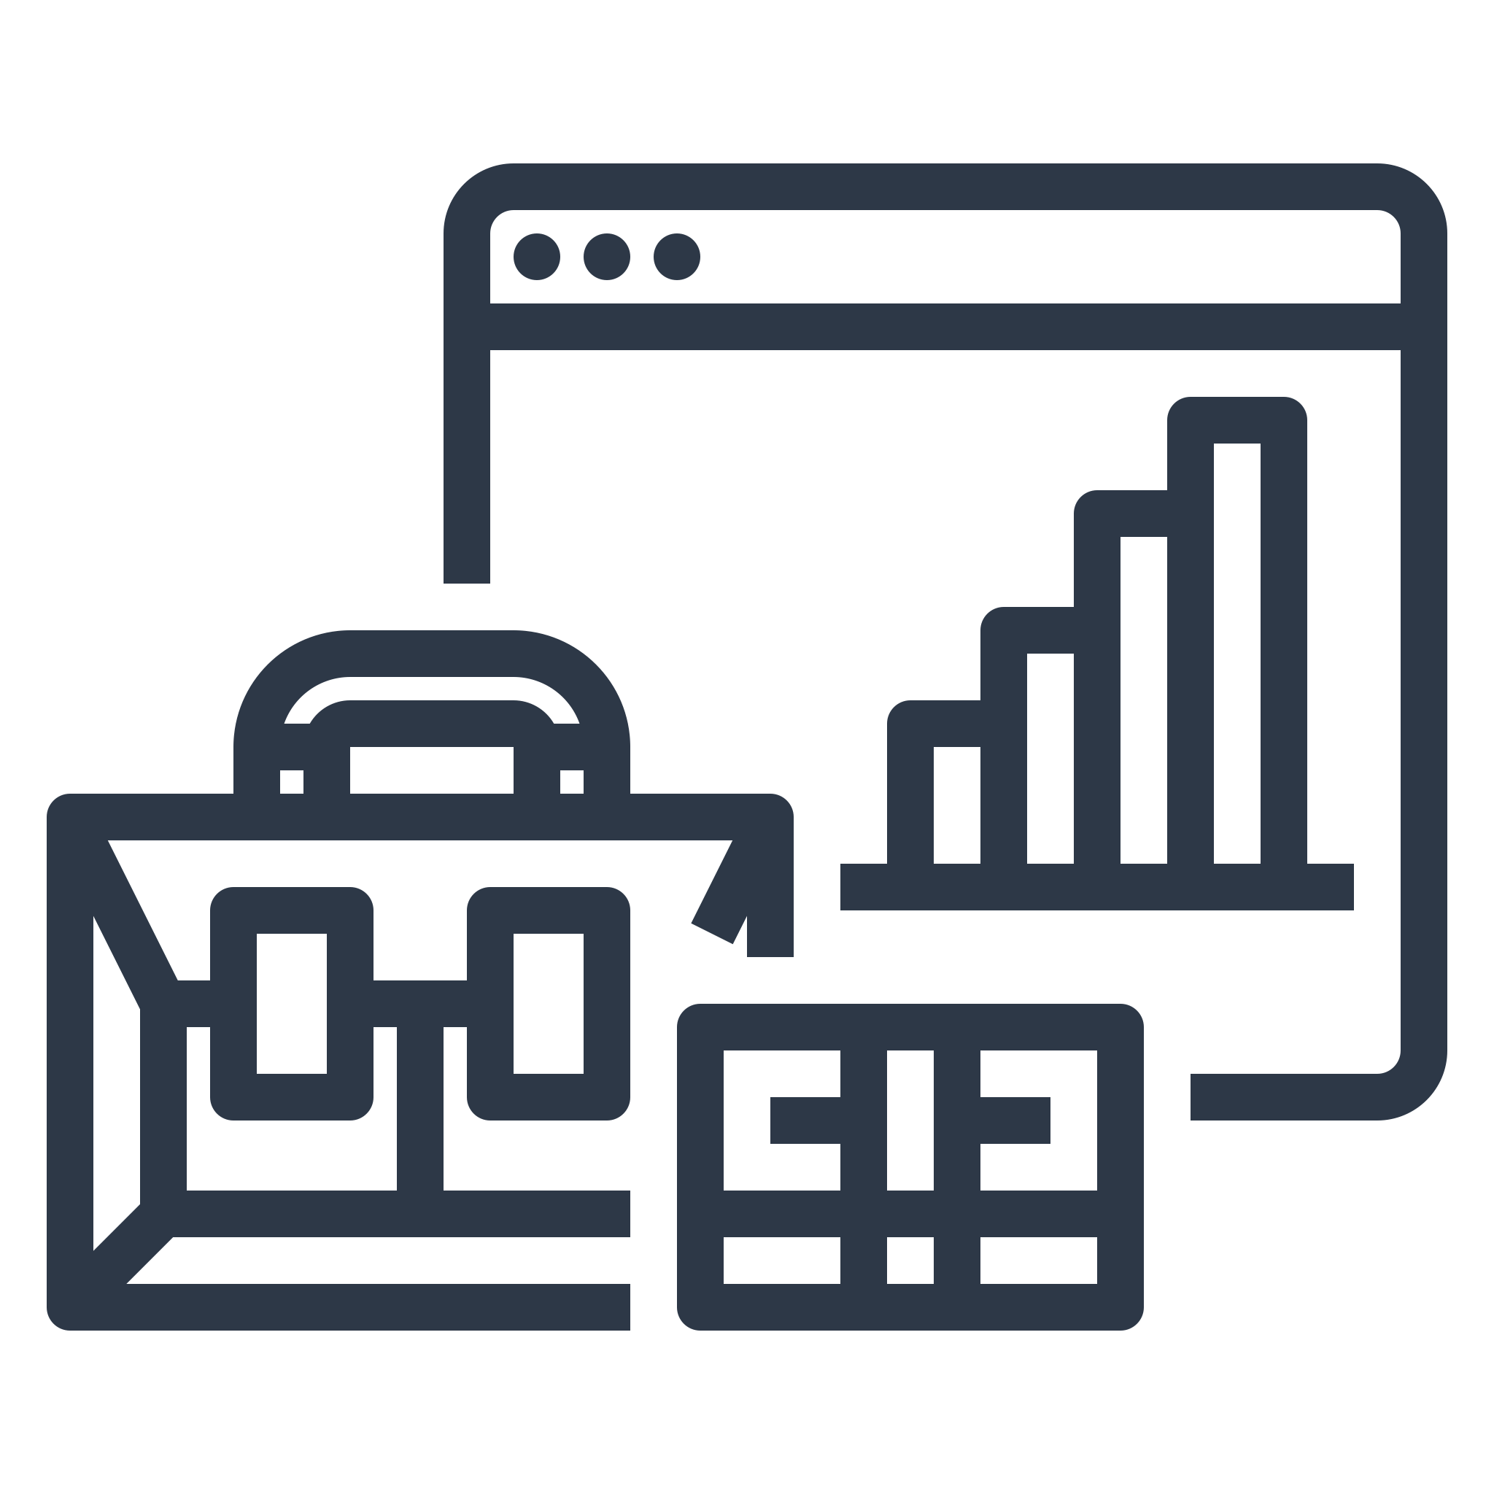

Roadmap
UI/UX Goldberg DAOs
First DAPP (Sol Vegas & Travian) template release
Cloud computed VR world
Q4 2021
Q1 2022
Q2 2022
Q4 2022
Q1 2023
Future
IDO launch
Land auction
Governance token auction
Game engine development w/ Multichain NFTs
Self-Destruction of the DAO and fully democratization of the platform to maximize Net Neutrality

Slide 10
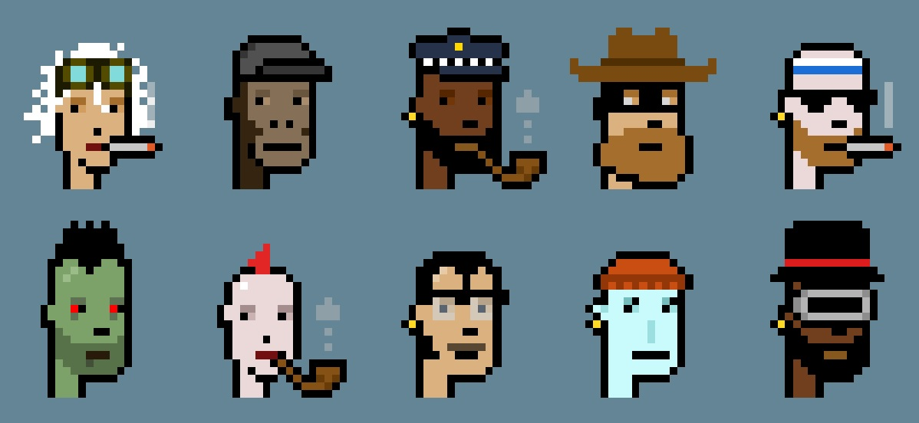
Rocco
Meta
Zekai
Crypto economic system lead
Game development lead
Principal engineer
The
Team
Andrea
Nicolas
Vik
UX lead
Blockchain developer
Blockchain developer
Tommy
Paolo
Edo
Game developer
Legal assistance
Business development

Slide 11
Hyper-Composable Molecular Mesh of Sub-Atomical Cross-DAOs with Multi-Chain Poly-Governance Landonomics and Dynamic Fartometer

Slide 12
MetaDots
Infinite Outcomes
Common Structure using a DAG
Inter-Planetary Inter-Chain communications through MetaDots (Player transactions etc)
Feeless computation for in-game NFTs (ammunitions, potions etc) and using DAG structure we are securing a Web2-like game experience in terms of latencies and costs
The DAG becomes the Data Availability layer for in-game events to offer a server-less level of decentralization
Tools and SDKs creations for easy and flawless gaming creation
VR Planet
on Etherum
VR Planet
on NEAR
Solarity
on Solana
VR Planet
on BSC
VR Planet
on Fantom
MetaDots
DAG Common Data
Data about every “Planet”, not tied to Blockchains

